Slide 1
NEW YORK
VENICE HIGH SCHOOL CHOIR
JUNE 9-13, 2023

Slide 2
BRT: Since 1981
Founded and owned by a band director
Carried over 550,000 travelers in over 6,500 trips
Disney Youth Programs PremEar Travel Planner
The top producer for Disney Performing Arts OnStage programs at the Walt Disney World® Resort
Recipient of Disney’s prestigious Partners Award
Member of the Student & Youth Travel Association and the National Tour Association
Sponsor of the Illinois Music Education Association, the National Band Association, the American Choral Directors Association, among others
Corporate sponsor of the Make-A-Wish Foundation

Slide 3
Trip Inclusions
Round-Trip Airfare (estimated at $400; subject to change until time of booking), luggage tags
Motor coach transportation to/from Tampa International Airport, gratuity for motor coach driver
7 days unlimited ride metrocard for subway and bus; round-trip Airtrain or NJ Transit ticket
4 nights’ accommodations at Sheraton New York Times Square; boxed breakfast each morning
Group Meal at Gayle’s Broadway Rose
Admission to Top of the Rock, Ticket to a Broadway Show
Excursions to Times Square, Rockefeller Center, Fifth Avenue, Central Park, 9/11 Memorial, Financial District, Columbus Circle, Chinatown, Little Italy, ride the Staten Island Ferry
Manhattan Concert Productions National Festival Chorus (inclusions next slide)
Onsite Company Tour Director, Company representative for airport check-in, all gratuities throughout the tour
BRT Video Souvenir & Tracking/Messaging App
BRT Payments – Online Individual Payment System

Slide 4
Manhattan Concert Productions Inclusions
Sound check and performance at Carnegie Hall
Festival chorus performance with a nationally-recognized guest conductor, professional soloists, the New York City Chamber Orchestra, opportunity to attend the remainder of the evening’s concert
Official performance photographer (with opportunity to purchase materials post-trip)
Post-concert buffet reception
Festival preparation by MCP staff, learning tracks, rehearsal space, collaborative pianist
Audio and video archival recording of your performance, certificate, MCP lanyard, framed mini-poster for ensemble
MCP Production Team
Non-Performer Package includes a premium ticket to the concert, access to rehearsals, and admission to the post-concert buffet reception

Slide 5
Payment Schedule & Estimated Pricing
Participant Type | Occupancy
Student Performer (45-49participants) | $2398 (all students in quad occupancy)
Chaperone Non-Performer | $1862 (double) $2491 (single)
Payment Details | Due Date | Amount Due
Registration | November 23 | No money due
Deposit | November 30 | $475 per traveler plus optional trip protection
2nd Payment | January 17 | $475 per traveler
3rd Payment | February 15 | $475 per traveler
4th Payment | March 15 | $475 per traveler
Final Payment | April 17 | Remaining Balance

Slide 6
BRT Payments – How to Register for the Trip
Click on the registration link from the registration form handout: https://bobrogerstravel.groupcollect.com/go/venice8939
Follow the steps from the registration form to register. Reserve your spot by entering all information requested in RED and enter a payment method. *A parent should register their child.
You can add Enhanced Trip Protection through TripMate when you register – Enhanced Trip Protection is highly recommended
Secure, online payment system
Receive reminder prior to each payment, select auto-pay for ease
Fund-raising amounts can be easily applied to your account until your account is paid in full
Estimated Trip Cost will depend on number of travelers and the final cost of airfare. The more people that go, the lower the cost will be!

Slide 7
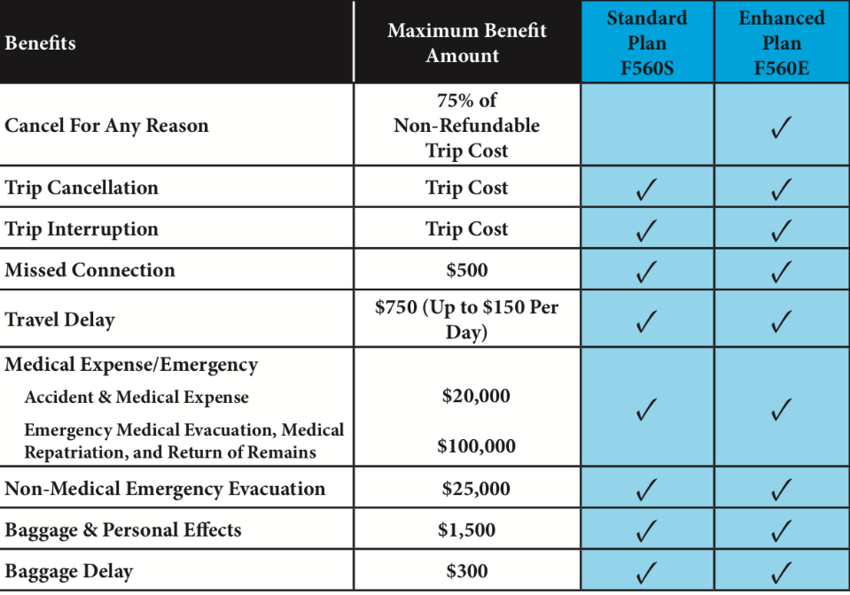
Enhanced (Cancel-For-Any-Reason) Trip Protection
Enhanced Trip Protection is highly recommended and can be added when you register for the trip.
See flyer for coverage details.
As part of your trip registration, you will choose Standard Protection, Enhanced Protection, or decline protection.
Your insurance premium will be charged when you make your trip deposit.
If you want to add Enhanced Trip Protection later, you can log into your account up to 14 days after your deposit to add it.
Questions? A licensed insurance agent can help you when you call the number on the flyer - (844) 777-6856

Slide 8
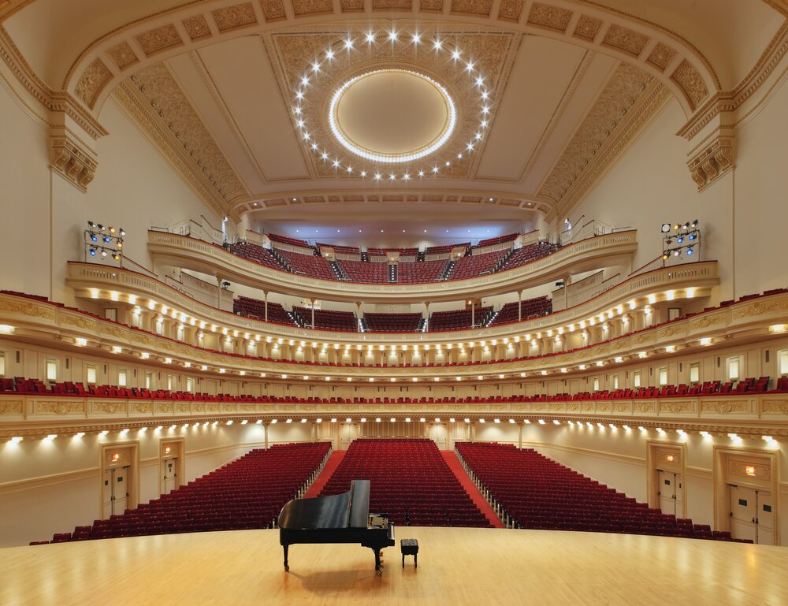
Files You Will Receive
Itinerary
TripMate Insurance Flyer
Registration Form
Go online and reserve your spot tonight!

